Slide 1
David: the fifth covenant

Slide 2
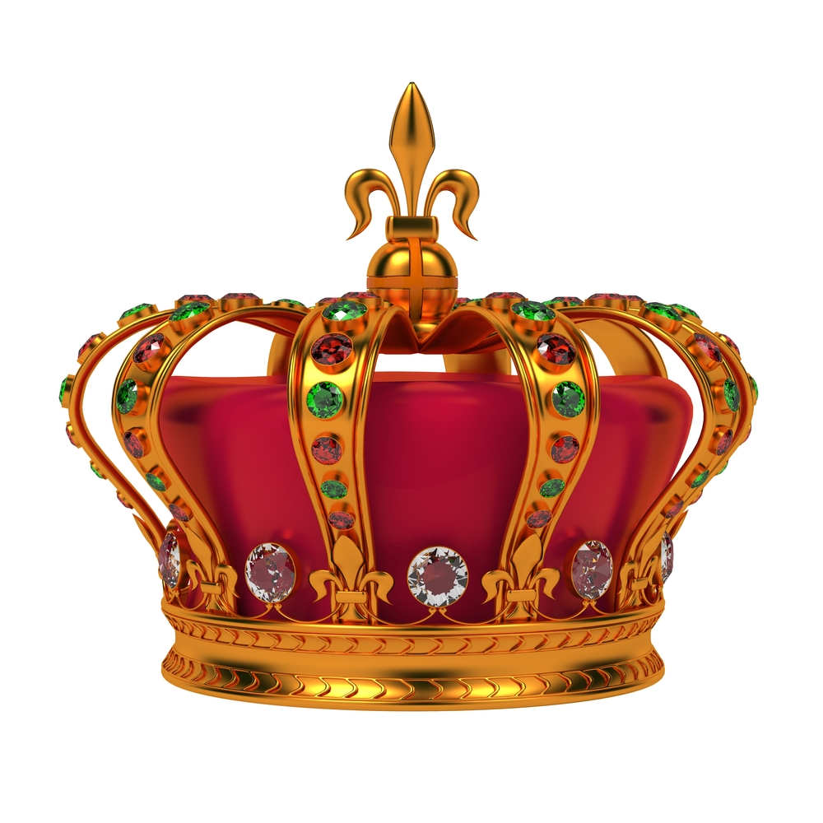
recap
Israel has gone from Judges to Kings
Samuel warns against it – why?
High taxes & political oppression
Not what God wants
The people insist and Samuel chooses Saul from the tribe of Benjamin

Slide 3
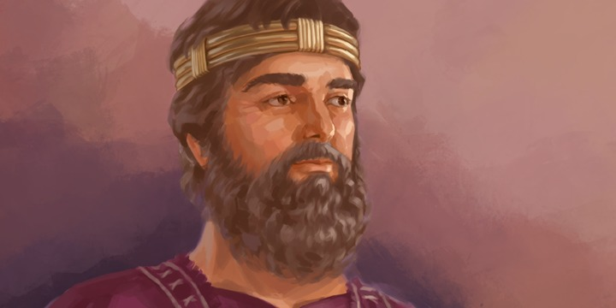
KING Saul
Looks like an ideal king
Starts off well but has a lot of character flaws
Insecure, envious, threatened by others’ successes, not good at worshipping God
They need a different king

Slide 4
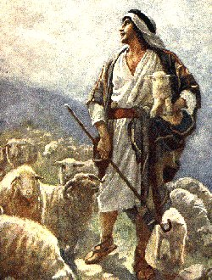
Who was David?
A shepherd boy from the family of Jesse
“Beloved One”
King & poet
Boaz & Ruth – great grandparents
He is mentioned over 1000 times in the Old Testament

Slide 5
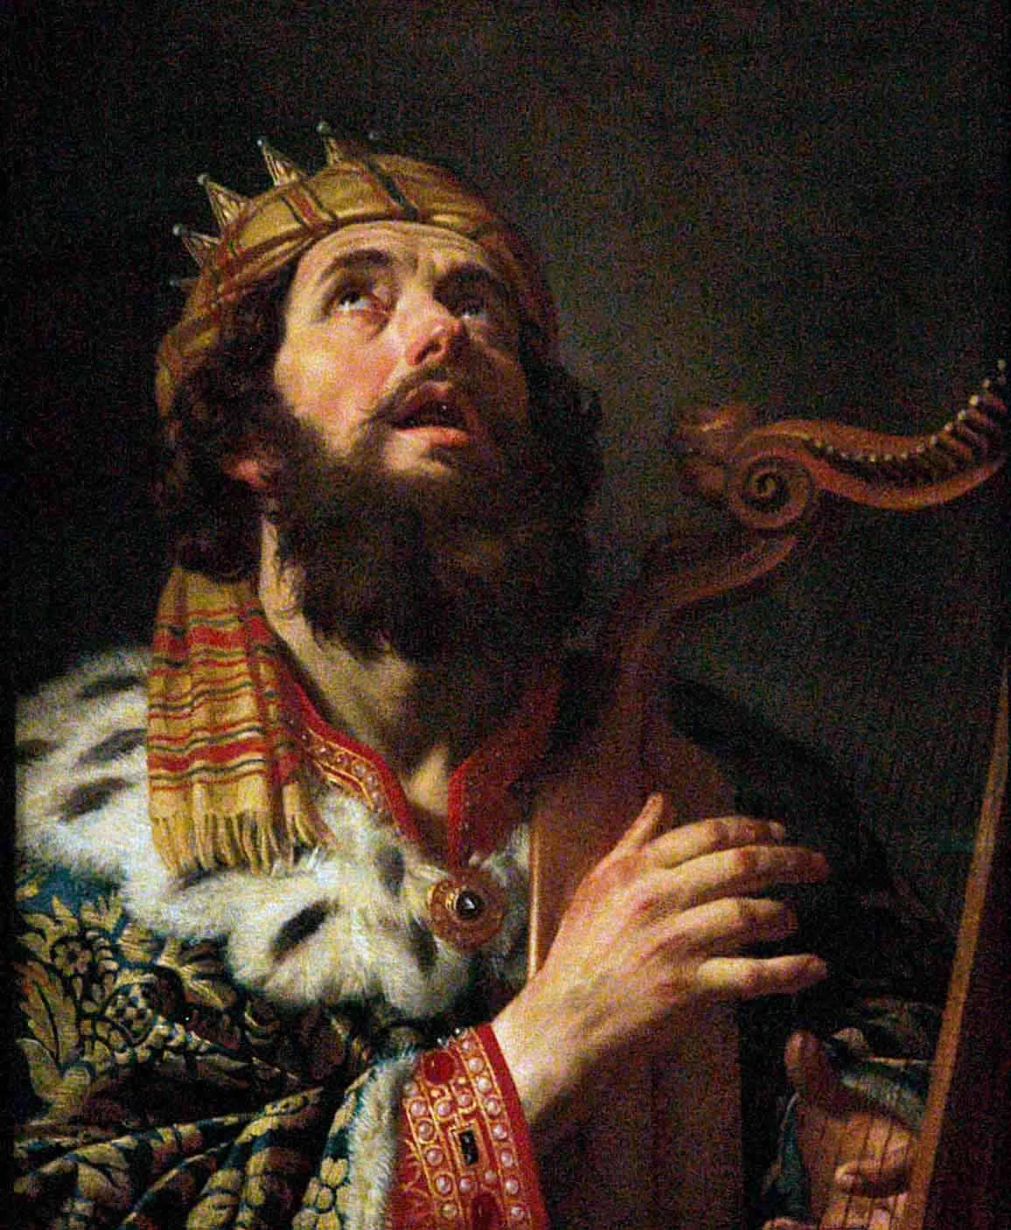
Why is he so important?
skillful warrior and brilliant general, unified 12 tribes, great empire
Established Jerusalem as the capital of Israel – to this day the greatest city of Israel
Great reformer - practiced what he preached
Showed the people how important worship was in their lives
Introduced singing and music into worship
Wrote most of the Psalms

Slide 6
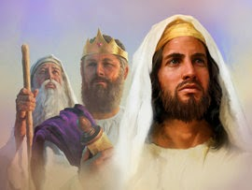
A sign of one to come
David foreshadowed Jesus Christ
He was a suffering king for much of his life
On the run from his father in law, Saul
Forced out of office by his son who plotted to kill him

Slide 7
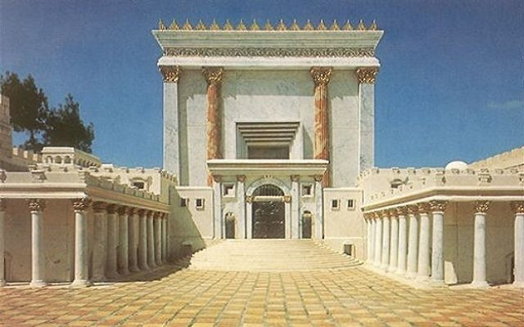
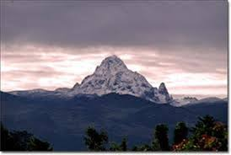
What is the covenant all about?
Promise: a son who will…
Build God’s temple
Be the Son of God
Rule over Israel forever
Given to David on Mount Zion in Jerusalem

Slide 8
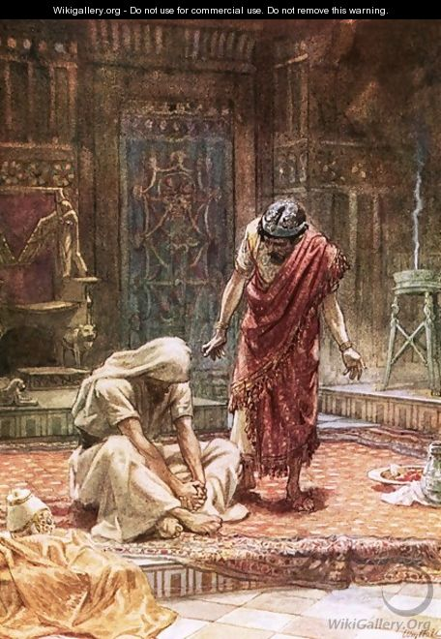
HE could rule an entire kingdom but not his own heart
Great Accomplishments:
United divided tribes
Makes Jerusalem the capital
Great, authentic love for God
Introduced singing & music into worship
Great Flaws:
Adultery
Murder
Betrayal
Pride
Coveting
Stealing
Notes:
We see David as one of the greatest figures since Moses – he united the tribes who were divided and not at peace, he established Jerusalem as the capital of Israel (one of the greatest cities even to this day), had a great love for God that was authentic, introduced singing and music into worship
– but obviously David had some serious character flaws
Adultery, murder, etc - Instead of confessing his sin and repenting, he makes a plot to kill one of his best friends (Uriah)
He could rule an entire kingdom but not his own heart
We see the importance of keeping our interior life in line with our exterior life
Because of his pride he tries to conceal his sin
He breaks several of the commandments – adultery, coveting, stealing, profaning the name of God who he is supposed to be a representative of
Israel becomes suspicious even though he tries to cover up
We see the need to be humble and admit when we are wrong and need help

Slide 9
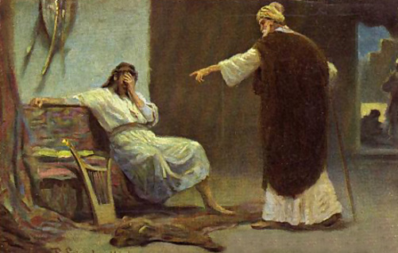
2 Samuel 11:27
“But the LORD was not pleased with what David had done”
Notes:
We know that David doesn’t just get away with what he has done…
2 Samuel 11:27 tells us, “But the LORD was not pleased with what David had done”

Slide 10
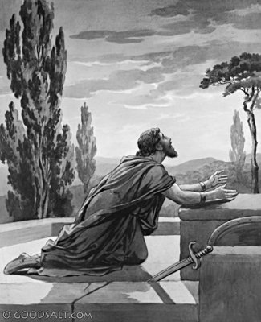
Though God forgives, the consequences are often not erased
the death of multiple sons
His sons repeated his mistakes – Solomon ends up marrying almost 1000 wives
Sons killed each other
Son sought to kill him
Notes:
God forgives him, but often the consequences of our sins cannot be erased – we have to face them and that was his punishment and often is ours
For David it was the death of his wife and multiple sons
His sons repeated his mistakes – Solomon ends up marrying almost 1000 wives
Sons killed each other
Sought to kill him
Despite all of this, we still look up to him as a great figure – remember he’s the first man since Adam to possess the 5 roles – son of God, king, priest, prophet, bridegroom – none of the other OT figures have been this good
So why do we still look up to him /what can we learn from him?

Slide 11
Psalm 51: the difference between David & Saul
Thoroughly wash away my guilt;
and from my sin cleanse me.
A clean heart create for me, God;
renew within me a steadfast spirit
Do not drive me from before your face,
nor take from me your holy spirit
Notes:
The difference between David and Saul - Instead of looking for someone to blame or rationalize his sin, David accepted his wrongdoing and quickly admitted how far he has gone from the righteousness he once had
Psalm 51 - We have seen the heartfelt and touching prayer of David in Psalms 51.
David is so sorrowful and he regretted all of what he has done.
He fervently asked God to wash him thoroughly and cleanse him from his sin (verse 3).
He prayerfully prayed to God to create in him a clean heart and renew a steadfast spirit within him (verse 10).
He was afraid that God would cast him away from His presence and take away the Holy Spirit from Him (verse 11).
Finally, we can still have the confidence and comfort that God is merciful and no sin is too great that God cannot forgive. No matter how big or small our sin, when we come to God is Merciful and there is no sin too great for him to forgive.
we have the assurance that God will forgive us. As this might be the case, we also have to be like David and repent when we have done wrong.

Slide 12
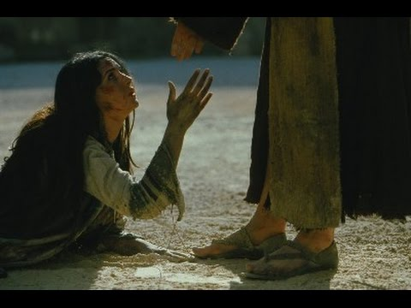
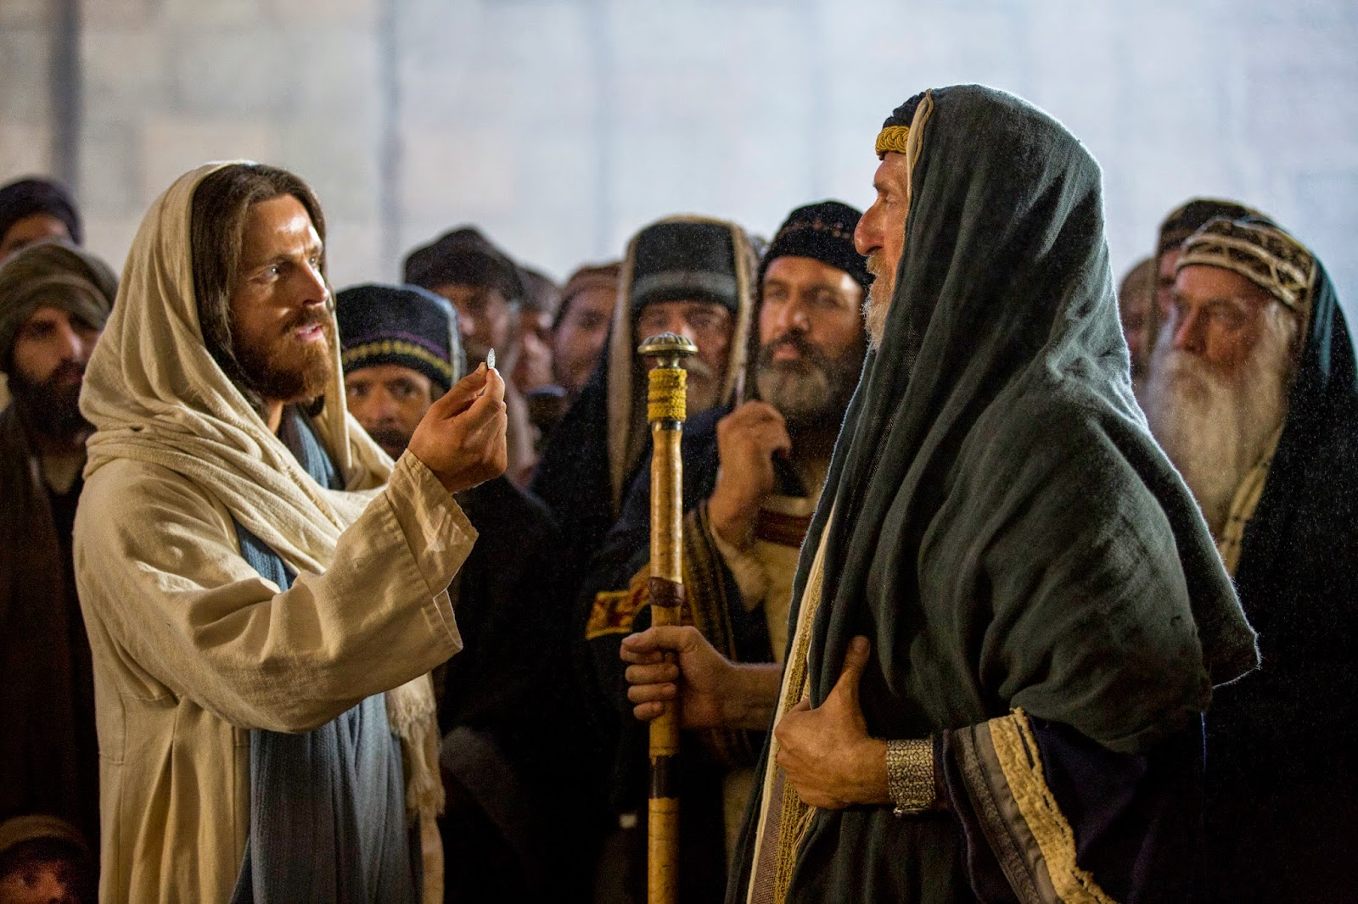
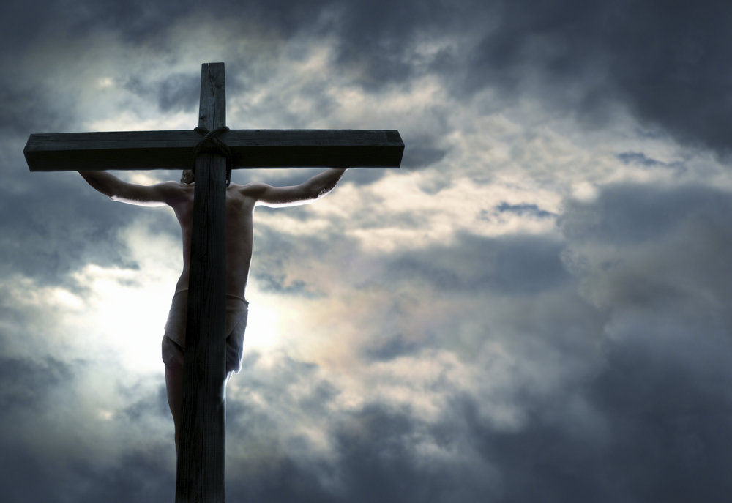
Ultimate lesson: God’s forgiveness
God loves sinners & uses flawed men and women to work out his plans
“I came not to call the righteous, but sinners”
Luke 5:32
“My power is made perfect weakness.”
2 Corinthians 12:9
Notes:
Ultimate Lesson: God’s Forgiveness
And herein lies the crux of this second lesson: God loves sinners, God uses sinners and flawed men and women. God can write straight with crooked lines, and make a way out of no way. Perhaps God should not have to, but he seems more than willing to use us, even in our brokenness.
St. Augustine
St. Peter
Mary Magdalene
David
Are there consequences to sin? Yes. But does God withdraw his love? Never. Even for those who finally refuse his Kingdom and it values
We should never doubt God’s love for us, no matter how deep our flaws or serious our sins. God will never forsake us. He may allow us to experience the consequences of our sins, as he did with David, and seems to be doing with us now, but God never withdraws his love or fails to shepherd us rightly. Whatever our sins, we have but to seek his mercy, like David, and accept his love. We are men and women after God’s own heart.
I will boast, but about myself I will not boast, except about my weaknesses.6Although if I should wish to boast, I would not be foolish, for I would be telling the truth. But I refrain, so that no one may think more of me than what he sees in me or hears from me7because of the abundance of the revelations. Therefore, that I might not become too elated,* a thorn in the flesh was given to me, an angel of Satan, to beat me, to keep me from being too elated.^{b}8Three times* I begged the Lord about this, that it might leave me,^{c}9* but he said to me, “My grace is sufficient for you, for power is made perfect in weakness.” I will rather boast most gladly of my weaknesses,* in order that the power of Christ may dwell with me.^{d}10Therefore, I am content with weaknesses, insults, hardships, persecutions, and constraints, for the sake of Christ;^{e} for when I am weak, then I am strong.*
The saints – are saints because they repented and turned told NOT because he was perfect though that is what many think
The saints are the ones who turn to God’s mercy the most
” There shall be joy in heaven upon one sinner that doth penance, more than ninety -nine just, who need not penance.” LUKE xv. 7

Slide 13
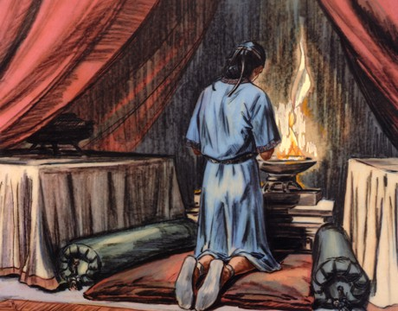
Positives to learn from David
He was not without limitations and admitted he needed God
He knew the mercy of God better than anyone
He was not without faults – didn’t pretend to be perfect
Not without troubles just because he followed God
Unifier – fought for peace
Notes:
He was not without limitations and admitted he needed God
He knew the mercy of God better than anyone
He was not without faults – didn’t pretend to be perfect
Not without troubles just because he followed God
Unifier

