Slide 1
Kings & prophets

Slide 2
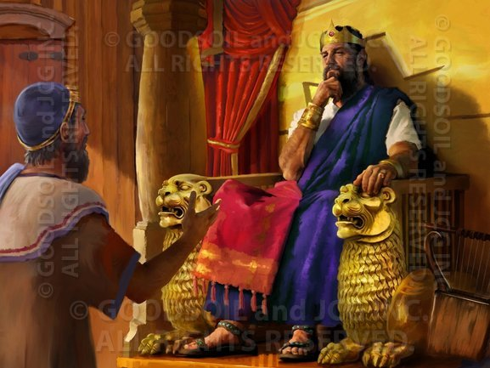
The Davidic kingdom : established forever
Notes:
God promises David in the covenant that his kingdom is going to last forever through his son
Solomon does take the throne, build God’s temple (his greatest achievement), and is the son of God through the covenant
Solomon’s reign doesn’t stay good for long – he marries thousands of women who are pagans and bring in idol worship to the kingdom
God repeats the condition of the covenant over and over in 1 Kgs for example – “If your sons take heed to their ways, to walk before me in faithfulness with all their heart and with all their soul, there shall not fail you a man on the throne of Israel." This means that as long as David's sons are disobedient the kingdom cannot be made secure for ever.”
Disobedience to the nation and to God brings the kingdom to ruin

Slide 3
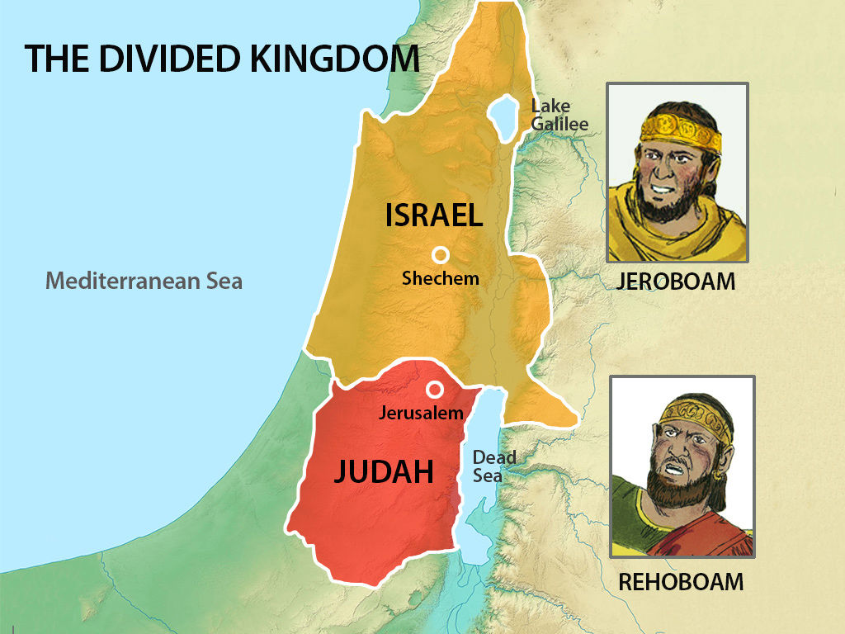
The kingdom divided: northern & Southern
Southern Kingdom of Judah – ruled by Rehoboam (Solomon’s Son)
Northern Kingdom of Israel – ruled by Jeroboam (Solomon’s servant)
Notes:
The people know one thing for sure: God had promised that the throne of David would be established forever some way
Obviously Solomon is not the only answer and neither is David’s descendants though they all live it out in some way
Downfall of the southern kingdom - Idolatry. Two ancient shrines in Dan and Bethel.

Slide 4
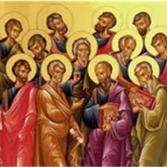
The prophets – the mouthpiece of God
1. PREEXILIC – lived and preached before the conquests of the Northern & Southern Kingdoms
2. EXILE – prophets who spoke during the exile of the Southern Kingdom
3. POSTEXILIC – prophets who exhorted Israel after exile of the southern kingdom
Notes:
What Samuel had warned had come true – kings were Israel’s downfall and ruin
Despite the people’s infidelity and sin he still calls them back to him and wants a relationship with them
What we are going to see next in history is a period of Exile where God sends prophets who use a number of methods from miracles, to metaphors, to poetry and writing to try to reach the people of Israel

Slide 5
Major & Minor Prophets
Major Prophets (4):
Isaiah
Jeremiah
Ezekiel
Daniel
Minor Prophets (12):
Hosea
Joel
Amos
Obadiah
Jonah
Micah
Nahum
Habakkuk
Zephaniah
Haggai
Zechariah
Malachi

Slide 6
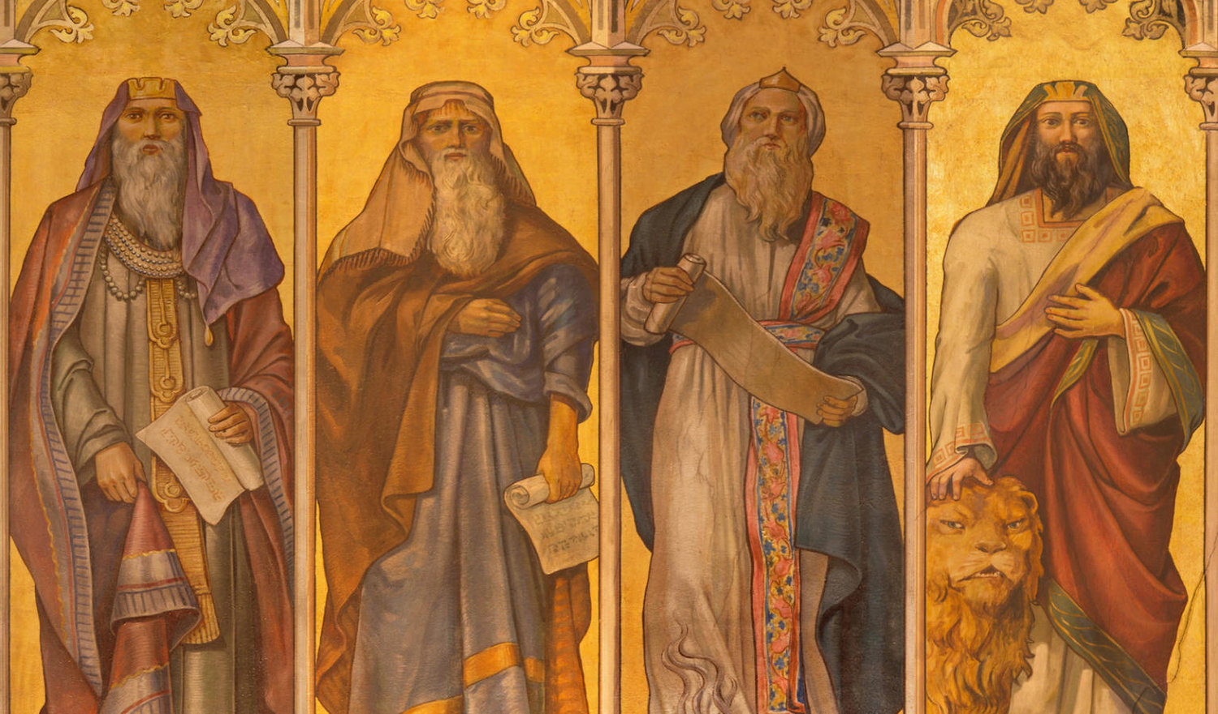
Basic message & Themes
Worship the One true God
Be just, especially to the poor
Know that God will ultimately triumph
Accept God’s love and mercy

Slide 7
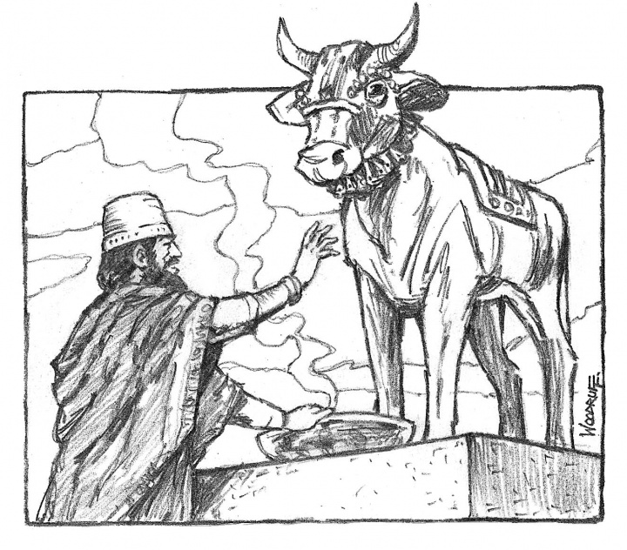
Pre-exilic prophets in the north
Notes:
Jeroboam (in charge of 10 tribes) sets up golden calf worship (not in Jerusalem)
Their king led the people away from God
Violated the first commandment

Slide 8
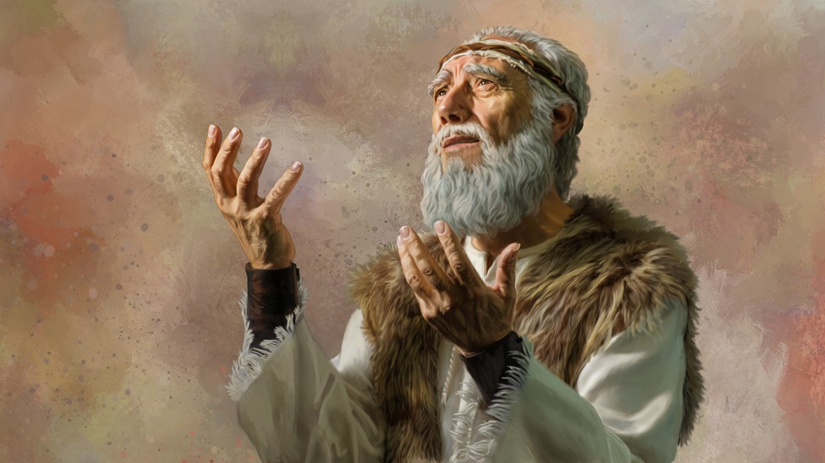
Elijah
9th century BC
King Ahab & Jezebel - Pagan religion took hold
Calls down a famine
Calls down fire from heaven
People believe in God and worship him
Greatest of the OT Prophets
Precursor and partner to the Messiah
Notes:
9th century BC
King Ahab & Jezebel
Pagan religion took hold
Elijah calls down a famine on the land to shock Israel back to fidelity
Proved their gods powerless by calling down fire upon a sacrifice
People believe in God and worship him
Jezebel threatened to kill him so he fled to the south
Greatest of the OT Prophets
Precursor and partner to the Messiah
Many people though Jesus was Elijah

Slide 9
Elisha
Great support for the poor, fidelity to God
Cured Naaman of leprosy
Worshipped the God of Israel
Nonwriting prophets

Slide 10
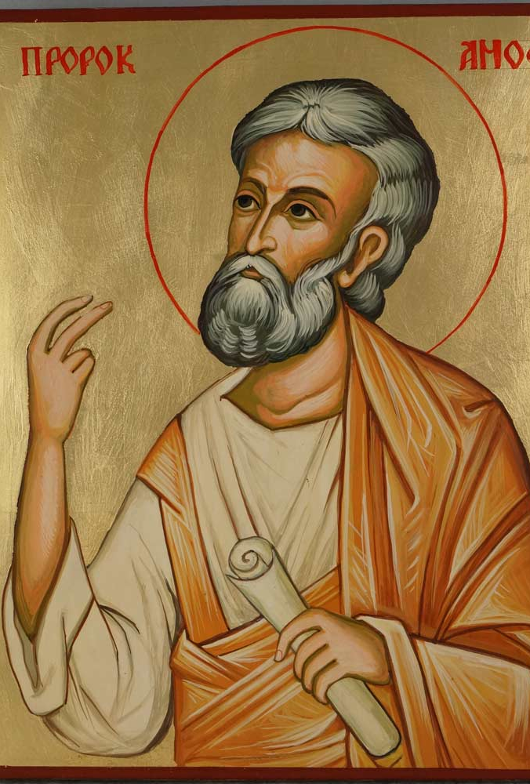
Amos
750 BC
Writing prophet
Prophet of social justice
Basic message: worship of must show itself in concrete deeds of mercy and justice to the weak and the poor
Repent of sins
Genocide, dishonesty, greed, sexual sins, robbery, violence, injustice, and pride
Banished from Israel

Slide 11
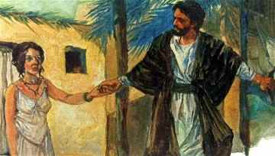
hosea
745 BC
Abandoned by his wife for another idol or man
Method: Drew on his painful marriage to describe Israel’s relationship with God
Main message: Israel had become an unfaithful lover who ignored God’s covenantal love
Infidelity, lying, murder, theft, and adultery
Sin resulted from not truly knowing God and all the good he has done for his people
“For it is loyalty that I desire and not sacrifice, and knowledge of God rather than burnt offerings.” ~ Hosea 6:6

Slide 12
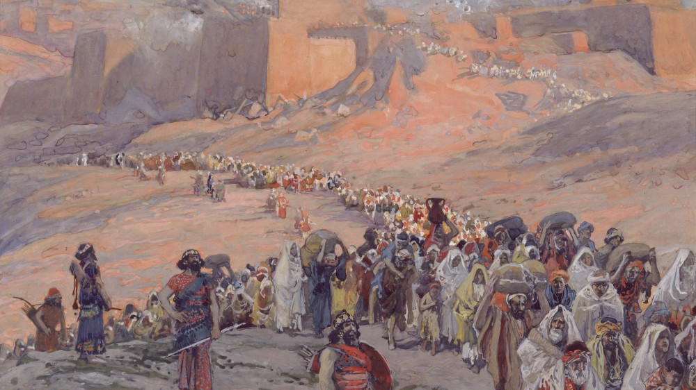
The fall of the northern kingdom
God continued to love the Israelites like a father for a son or a husband for a wife
Assyria captured Babylon and marched to Egypt
Kingdom destroyed in 722 BC
27,000 Israelites go into Exile
End of the Northern Kingdom

Slide 13
Assignment
1 Kings 17-19
What does Elijah do for the widow?
How did Elijah taunt the false prophets of Baal?
Where did Elijah find the Lord God?
Amos 7-8, Hosea 1-3
What is the meaning of Amos’s visions?
List some of the sins of Gomer (Israel). See commentary in the Bible for more info.
What does Hosea 3 say about the outcome of the love between God and Israel?

